Slide 1
The Rotary Club of Hunterston
‘ Message In A Bottle ’
Emergency Information Scheme
For The Three Towns .
Notes:
Emergency Information Scheme

Slide 2
The Rotary Club of Hunterston
What is the Scheme?‘
The ‘Message in a Bottle’ is an Emergency Information Scheme aimed at anyone who feels vulnerable at home.
It provides Emergency Services with vital details of existing conditions and allergies of any vulnerable person and a contact name if they are called to their home.
Bottles will be available to all free of charge

Slide 3
The Rotary Club of Hunterston
Background.
The ‘Message in a Bottle’ scheme has been operated successfully by Rotary clubs and others in Britain for over 10 years.
Schemes are operational in Renfrewshire, parts of Dumfries & Galloway & Highlands
Our club introduced the scheme in West Kilbride in 2013 and other clubs introduced the scheme in South Ayrshire in 2016.

Slide 4
The Rotary Club of Hunterston
Which local Emergency Services agreed to use the scheme?-
The Scottish Ambulance Service (Kilwinning)- David Mackintosh Area Service Manager
Strathclyde Fire & Rescue (Ardrossan)- Kevin Hughes Station Manager
Police Scotland(Saltcoats)- Inspector Colin Convery

Slide 5
The Rotary Club of Hunterston
How does the scheme work for the user?
Your details are stored in a clearly labelled plastic bottle which is kept in your fridge door.
Two matching labels, known to the Emergency Services and other care agencies, are displayed in your house.
Quick access to your details in the bottle will enable others to help you more effectively in an emergency situation.
Provides you with peace of mind.

Slide 6
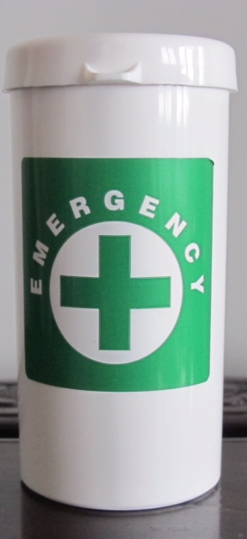
The Rotary Club of Hunterston
The ‘Bottle’ The bottle is 10cm long and 4.5cm diameter and contains the Emergency Data Sheet, Instructions +2 Green Cross Labels.

Slide 9
The Rotary Club of Hunterston
What is the ‘Message’
The message is a Data Sheet which contains
1) Personal Details such as
Your First Name………………………………………
Your Last Name…………………………………………
Male □ Female □ Approx Height ….. …… Approx Weight ………..
Date of Birth …………………………… Date you completed this form ………

Slide 10
The Rotary Club of Hunterston
2) Doctor’s Details
Doctor’s Name ……………………………………
Doctor’s Address………………………………… ……………………………………………………… Tel No. …………………………

Slide 11
The Rotary Club of Hunterston
3) Medical Details
I take no regular medication…. □
Do you have: -
Asthma……………………□ Diabetes ……………□
Heart Problems …………□Anti Coagulant Therapy Epilepsy…………………. □ (e.g Warfarin) □
Other □ (please give details below)
……………………………………………………………

Slide 12
The Rotary Club of Hunterston
4)Medical Details ( cont’d)
Have you taken steroids recently? Yes □ No □
Are you allergic to anything, including medication? Yes □ No □ (if yes please give details below)
……………………………………………………………………
Do you have a hearing aid? Yes □ No □
Do you have any serious visual problems? Yes □ No□

Slide 13
The Rotary Club of Hunterston
5) Emergency Details such as
In Case of Emergency who can we contact?
1. Name: …………………… 2. Name:.…………………………
Telephone No. ……………… Telephone No.……………………
Address:……………………… Address:…...………………………
……………………………… ………………………………
Relationship to you: ………… Relationship to you …………………
Do you have a person or a pet relying on you for daily care?
(if yes please give details below)

Slide 14
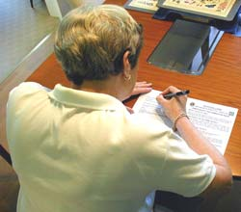
The Rotary Club of Hunterston
What does the user have to do ?
1) The Form
Complete the Data Form provided, using CAPITALS and a ballpoint pen. If possible attach a small passport style photo.

Slide 15
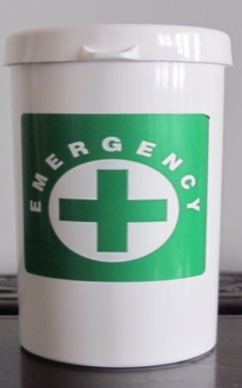
The Rotary Club of Hunterston
What does the user have to do ?
2) Others in the house. If there are other people in your household who may benefit from this scheme, each one should use a separate bottle and mark the bottle clearly e.g. MR or MRS.

Slide 16
The Rotary Club of Hunterston
What does the user have to do ?
3) Roll your form up and put it back into the bottle. If you have one, enclose your up to date repeat prescription form. Replace the lid.

Slide 17
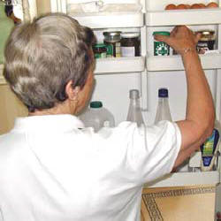
The Rotary Club of Hunterston
What does the user have to do ?
4)Place the bottle/s in your fridge door where it will be clearly visible and safe.

Slide 18
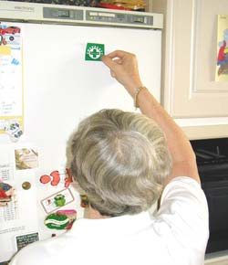
The Rotary Club of Hunterston
What does the user have to do ?
5) Stick the first label to the outside of your fridge door.

Slide 19
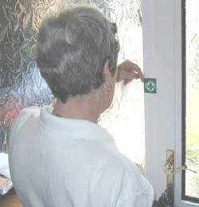
The Rotary Club of Hunterston
What does the user have to do ?
6) Stick the other label inside your front door (placed so that it is not visible from outside).

Slide 20
The Rotary Club of Hunterston
What does the user have to do ?
7) Keep the Information up to date !

Slide 21
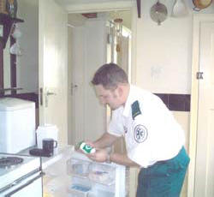
The Rotary Club of Hunterston
How will the Emergency Services use the scheme?
The Emergency Services will know to look out for the Green Cross label when they enter the home. Bottle with contents can go with patient to hospital.

Slide 22
Rotary Club of Hunterston
Funding and Organisation
Grant from the The Community Benefit Fund (Ardrossan Windfarm).
Funds of Rotary Club of Hunterston
Each bottle and contents cost approx 30p
Bottles sourced, prepared and distributed by members of Rotary.

Slide 23
Rotary Club of Hunterston
Quantities :
Estimates from other areas suggest 10% of population may use bottles
Population of Three Towns is approx 33,000
Our initial stock is 3,150 bottles
Distributed to date 1,100

Slide 24
The Rotary Club of Hunterston
Distribution. 20 Outlets in the Three Towns
All 8 Pharmacies
All 4 Doctor’s Surgeries
All 3 Libraries
Three Towns OIR
Thistle Day Centre
Castleview Day Centre
The Hope Project Centre
St Cuthbert’s Church Community Cafe

Slide 27
Rotary Club of Hunterston
Questions ?

Slide 28
Rotary Club of Hunterston

